Slide 1
LC3 pipeline

Slide 2
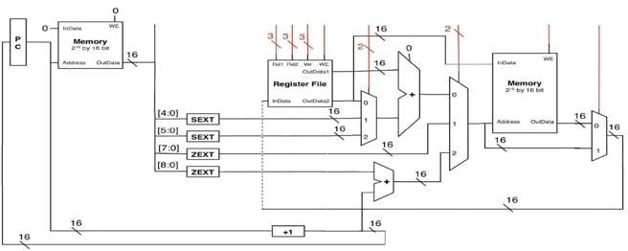
LC3 hardware control
CONTROL

Slide 3
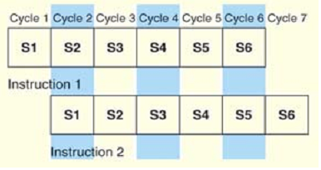

Pipeline 6 stages
Each stage of the Instruction Processing Cycle takes 1 clock cycle
1 clock cycle = x time units per stage
For each stage, one phase of instruction is carried out, and the stages are overlapped

Slide 4
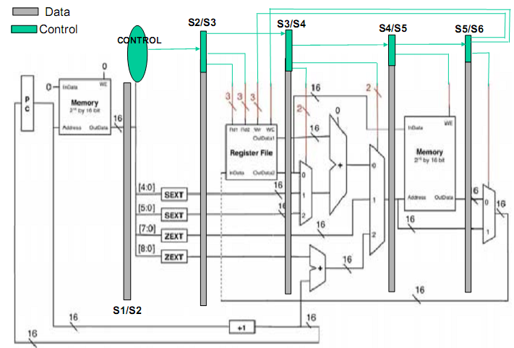
LC3 Pipeline

Slide 5
Pipeline hazards
There are three kinds of pipeline hazards:
1. Structural Hazard
2. Data Hazard
3. Control Hazard

Slide 6
1) Structural hazards
Occurs when hardware cannot support a combination of instructions that we want to execute in parallel
In Laundry example: the machine has combined washer or dryer
In instruction pipelining, it usually occurs when one hardware is shared amongst two stages that work in parallel
Example: Memory or Register File
Usually overcome by duplicating hardware
Memory is separated into instruction and data memory
Or memory/register is multi-ported i.e. memory that provides more than one access path to its contents

Slide 7
2) Data hazards
Occurs when an instruction depends on the results of
a instruction still in the pipeline
•Example 1:
i1: ADD R1, R2, R3
i2: AND R5, R1, R4
•Example 2:
i1: ADD R1, R2, R3
i2: ST R1, A
•Example 3:
i1: LD R1, A
i2: ADD R2, R1, R2

Slide 8
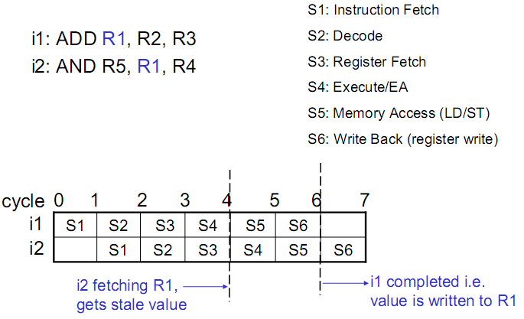
2) Data hazards: Example 1

Slide 9
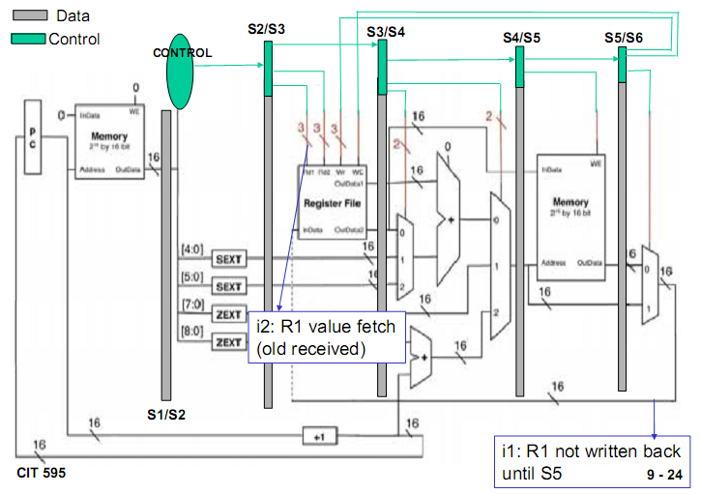
2) Data hazards: Example 1

Slide 10
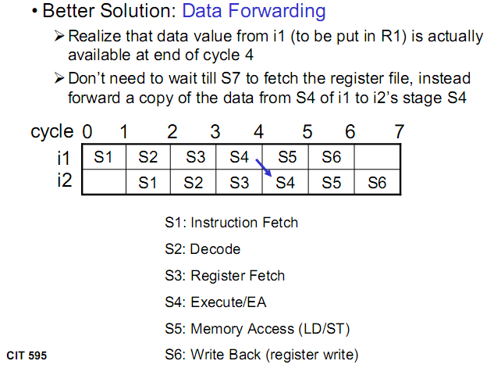
Solution 1

Slide 11
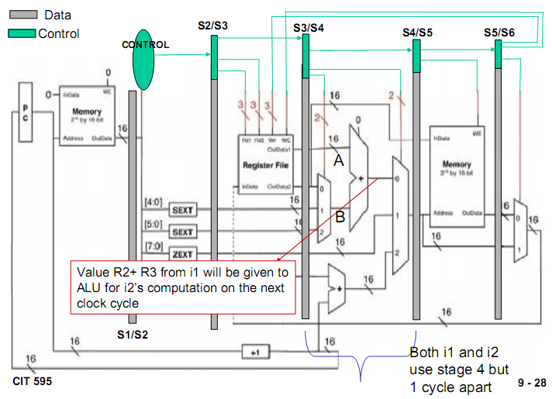

Slide 12
3) Control hazards
Occurs when we need to make a decision based on the result of instruction while others are executing
Branch Instructions are instructions that make decision
Alter the flow of execution in a program and give rise to control hazard

Slide 13
LC3 with 5 stages pipeline
IF
ID
EX
MEM
WB
Hazard
detection
Unit
Forwarding
unit

Slide 14
branch
nzp[2:0]
IF/ID
ID/EX
+
00
EX/MEM
MEM/WB
wr_stack
Stack
rd_stack
pc_out[15:0]
01
br[15:0]
con_br
uncon_br
1
pc_in[15:0]
10
NZP
0
11
1
+
SR1[2:0]
Register
file
Ra[15:0]
mem_wr
SR2[2:0]
00
1
Instruction
Memory
IR[15:0]
addr
01
Data
Memory
DR[2:0]
ALU
addr[15:0]
10
0
1
rd_da[15:0]
0
PC
WD[15:0]
Rb[15:0]
00
wr_da[15:0]
0
1
01
0
RegWR
10
mem_rd
memtoreg
pc_wr
1
sel_ext[2:0]
Extend
trap
IR[10:0]
extend[15:0]
forward_a
Control
unit
0
IR[10:0]
1
WB
MEM
EX
forward_b
WB
MEM
WB
0
SR1[2:0]
Forwarding
Unit
RegWR_ex_mem
DR_ex_mem[2:0]
ID_flush
SR2[2:0]
RegWR_mem_wb
br
Hazard
Detection
Unit
mem_rd
DR_mem_wb[2:0]
trap
SR1[2:0]
SR2[2:0]
DR_id_ex[2:0]

